Slide 1
DEEPFAKE DETECTION
Team starks
07/02/2024

Slide 2
The problem statement
1. Deepfake Menace: In an era defined by technological advancement, the rise of deepfakes, powered by AI, poses a significant threat. Reports, like the World Economic Forum's Global Risks Report, emphasize AI-generated misinformation as a major global risk, surpassing concerns about climate change.
2. Political Integrity at Stake: Deepfake instances, including AI-crafted speeches by political leaders and manipulated videos impacting election integrity, highlight the profound impact on political narratives. With crucial global elections approaching, there's a pressing need to combat deepfakes' potential to manipulate public opinion.
3. Urgent Call for Deepfake Detection: The escalating threat calls for urgent action in developing advanced deepfake detection mechanisms. Generative AI tools like ChatGPT raise concerns about the ease of manipulation, underscoring the necessity to safeguard information authenticity, protect democratic processes, and ensure trust and truth prevail.

Slide 3
Technical stack
Programming languages: Python
Machine learning frameworks: TensorFlow , Pytorch , Keras , Scikit Learn
FastAPI
React
Mongo DB

Slide 4
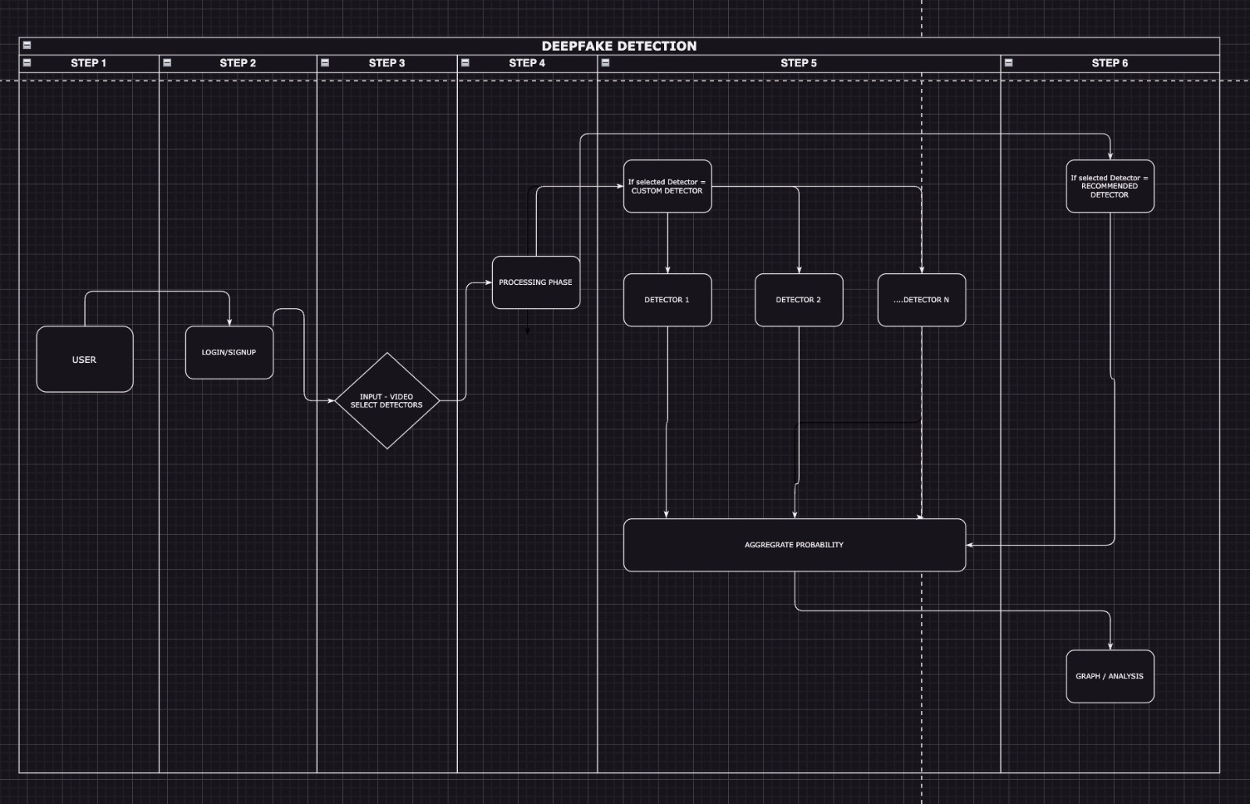
USERFLOW DIAGRAM

Slide 5
Key features
Specialized Detectors for Comprehensive Detection: Employing multiple detectors trained to detect specific kinds of manipulations in videos ensures comprehensive coverage, making adversarial attacks more challenging and minimizing the risk of missing deepfakes.
Efficient Video Processing Techniques: Utilizing fast video processing techniques like Mediapipe and implementing parallel processing significantly reduces computational overhead, enabling quicker analysis of videos without compromising accuracy.
Aggregate Model for Enhanced Insights: A specially designed aggregate model considers individual probabilities from multiple detectors to produce an aggregated probability, addressing conflicting probabilities and providing more insightful results to users.
Continuous Improvement through Human-in-Loop System: Incorporating a human-in-loop system allows for the analysis of video inputs and outputs by experts, facilitating continuous improvement of the detection models based on historical performance and feedback.
Dataset Expansion: The system's adaptability to emerging deepfake technologies is enhanced by continuously generating historical performance data for newer models using custom datasets combining diverse sources like DFDC, CelebDf, and Face Forensic ++.

Slide 6
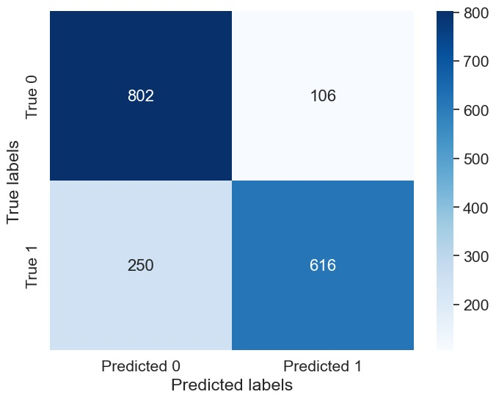
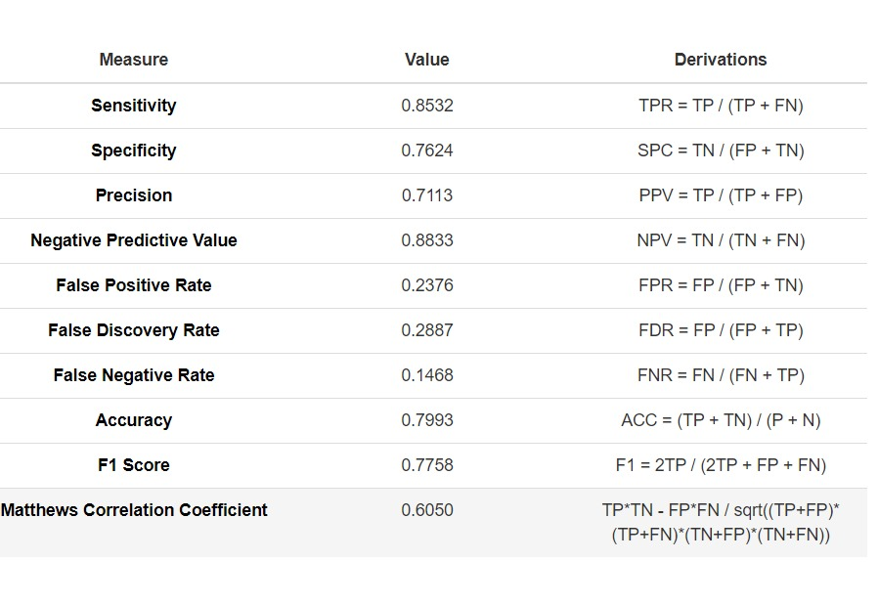
AI Model DEVELOPMENT
Obtaining open source detectors
Defining the model architecture for probability aggregation
Historic performance data preparation
Training aggregate model
Improving accuracy by analyzing the performance metrics

Slide 7
Results
On paper, a commendable accuracy of 79% has been achieved, exceeding the project's initial aim of 75%.
Users have the ability to upload videos and receive outputs in the form of easily interpretable graphs.
The website currently functions with an intuitive user interface and user experience.

Slide 8
Team members
Shrish Kumar - Frontend Developer & AI/ML Developer
B. Mahesh Raj - AI/ML Developer
Kishore Kuttalam R. - AI/ML Developer
Advaith Sajeev - Full stack and AI/ML Developer
Sarath Chandran - Backend Developer & AI/ML Developer

Slide 9
THANK YOU

